Slide 1
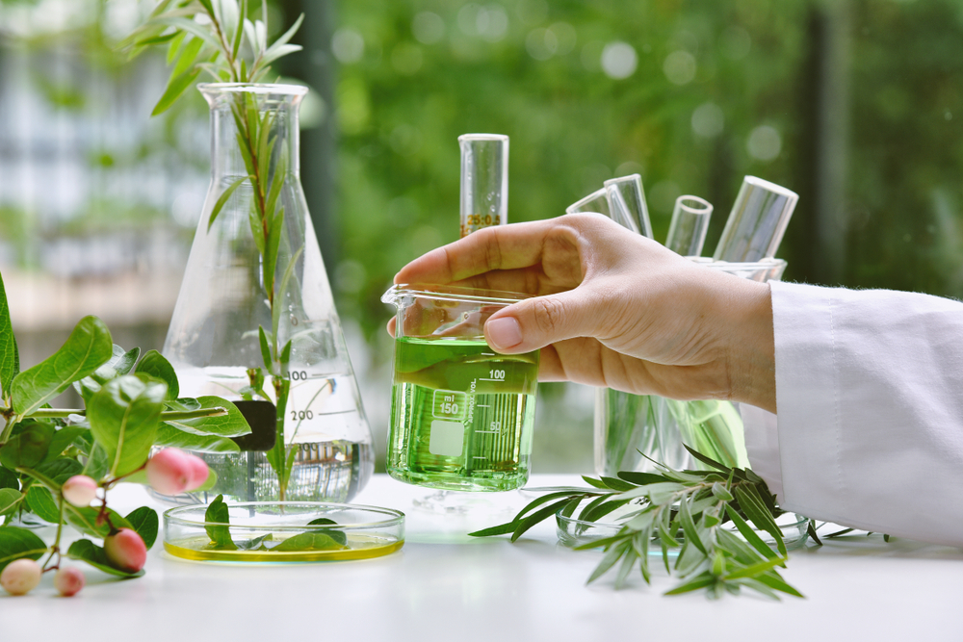

Biotransformation of Sugarcane Bagasse Extract into High-Value Dextran: A Microbial Valorization Approach
Internship Project
Presented by Prakhar
BT22BTECH11012
Supervisor: Dr. Althuri Avanthi

Slide 2
Introduction
Material & Methods
Results & Discussion
Conclusion & Future Perspective
References
01
Table of Content
02
03
04
05

Slide 3

Problem Statement
Dextran is a high-value, low-volume product with a high market price, primarily due to its low yield and the high production cost.
High cost of commercial Sucrose
High demand and cost of Ethanol
Need to reduce the dependency on ethanol
Need to find cheaper sucrose source
Sucrose from Sugarcane Bagasse
Reduce the need of ethanol & implement reuse

Slide 4
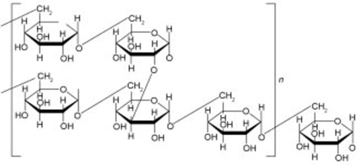

Introduction
Structure and characteristics of Dextran
Dextran is a branched-complex exopolysaccharide made entirely of glucose.
Backbone: α-(1→6) glycosidic linkages
Side branches: Mostly α-(1→3), occasionally α-(1→2) and α-(1→4)
Structure
High Water Solubility
Biocompatibility
Biodegradability
Properties
Medical: Plasma expanders (Dextran 40/70), anticoagulants, MRI enhancer
Food: Thickener, stabilizer, moisture retention
Biotech: Protein separation, sweeteners
Applications

Slide 5
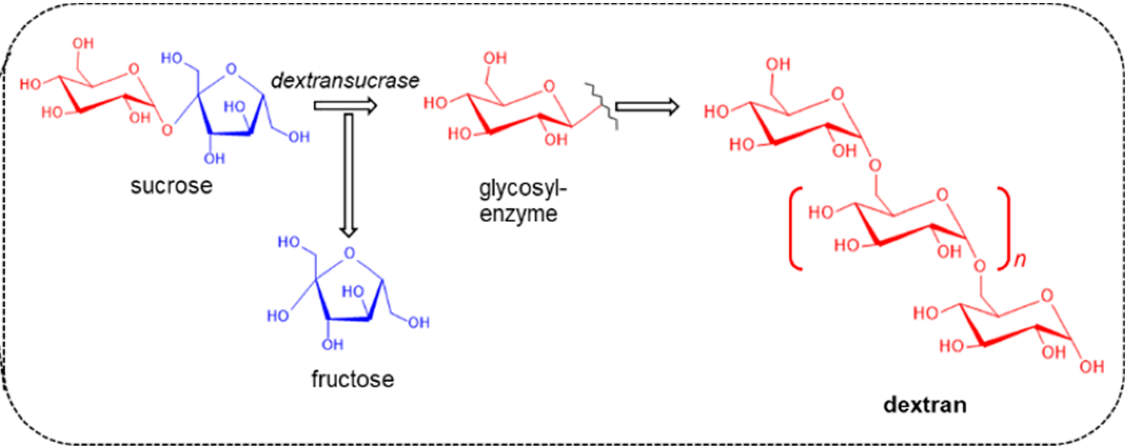
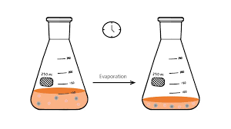

Biosynthesis of Dextran and Industrial Applications
Leuconostoc Mesenteroides
(NCIM 2073)
Industrial strain
(95% α-(1→6) + 5% α-(1→3)) is used.
Dextransucrase enzyme – helps to synthesize dextran from sucrose
Catalyzes transfer of glucose from sucrose to dextran chain
By-product: Fructose
Requires additional nutrients:
CaCl2 & MnSO4.H2O: To Enhance dextransucrase activity
NaCl: Increases dextran yield

Slide 6

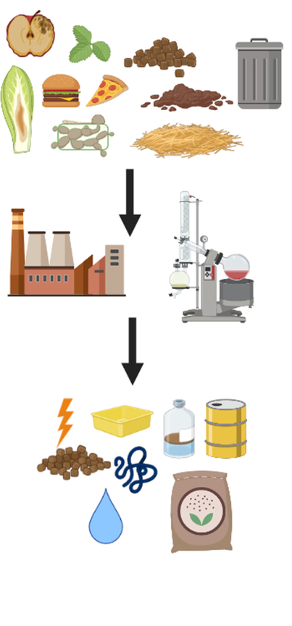
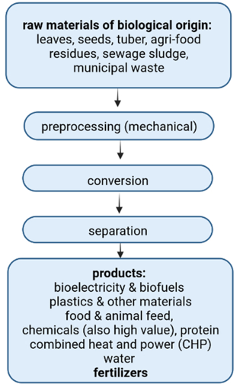
Waste Valorisation
Foods Crops
Biorefinery
Food Security
Biomaterial/Platform chemicals synthesis
Solution is Agricultural waste
Value added product
Burned/ Compost/ left in the field
Present study
Sugarcane Bagasse Dextran

Slide 7
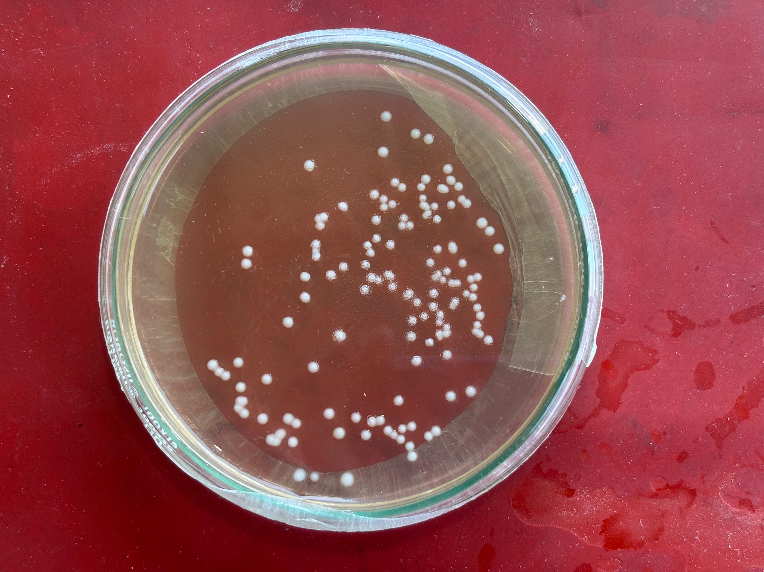
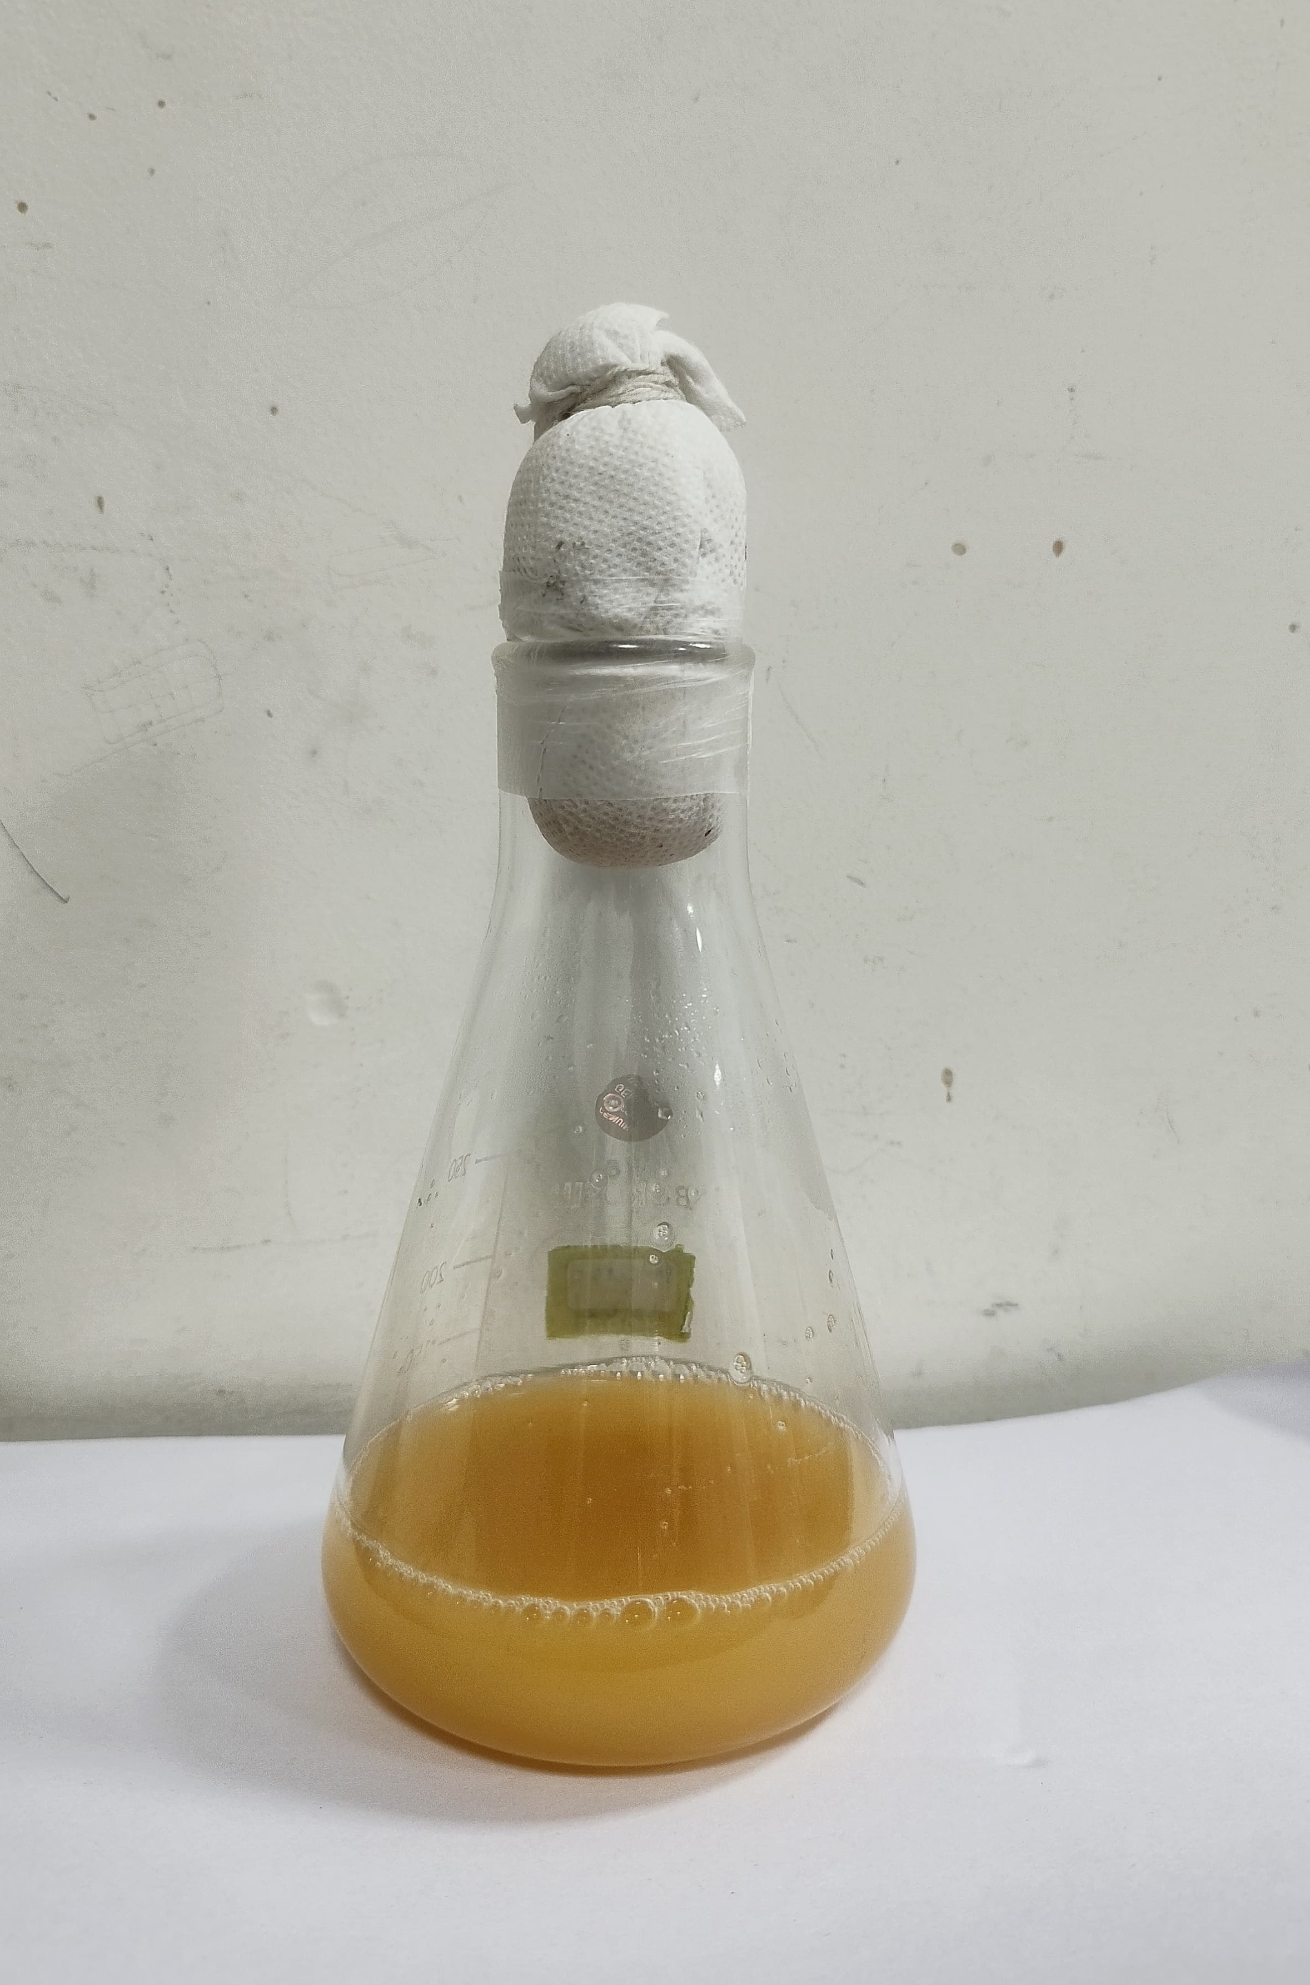
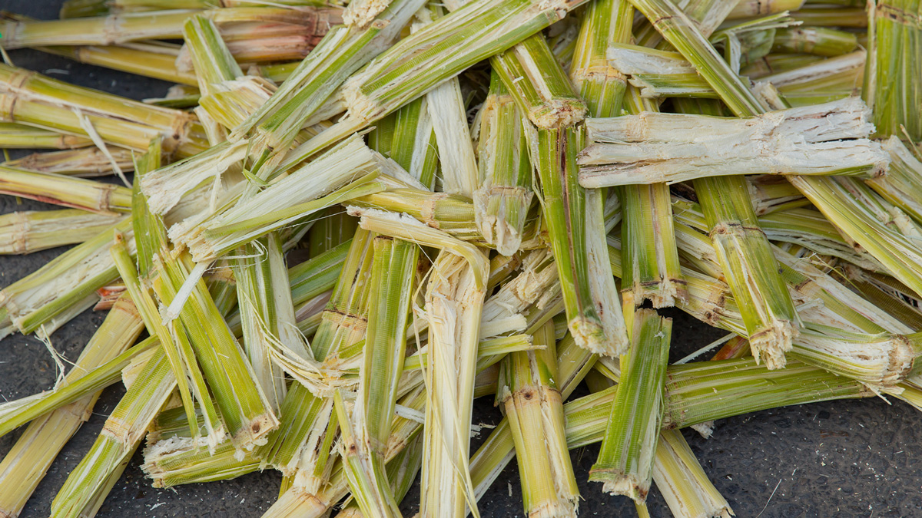
Materials & Methods
Microbial Strain
Leuconostoc mesenteroides(NCIM 2073) obtained from NCIM, Pune
Preserved in 25% glycerol stock at 4°C
Growth kinetics study
(L.mesenteroides)
Cultured in MRS broth at 25°C, 100 rpm
OD measured at 600 nm every 3 hours
Substrate – Sugarcane Bagasse (SCB)
Collected from Sangareddy local market, Telangana
Oven-dried, ground to 0.25 mm particle size for use

Slide 8
Sucrose Extraction and Fermentation Setup
Components per mL: Yeast extract (0.01 g/ml), K₂HPO₄ (0.03 g/ml)
Water used as the solvent
pH - 7–8
Aqueous
Extraction of Sucrose
Fermentation
Minimal salts added: CaCl₂, NaCl, MnSO₄·H₂O
Parameters studied:
Temperature ( 25°C & 90°C)
Feedstock concentration (4-12 w/v%)
Extraction time (10–50 mins)
Sterilized at 121°C for 15 min, cooled to 25°C
The media was inoculated with 10% of inoculum
Modified Anthrone method used to estimate sucrose concentration
Incubated at 25°C, 100 rpm in orbital shaker

Slide 9

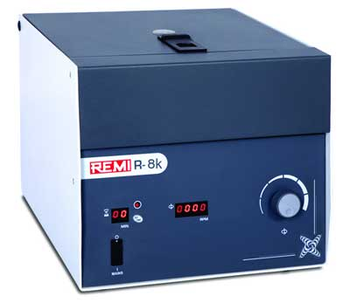
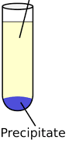
Dextran Recovery & Purification
Post- Fermentation Processing
Cell debris
Broth centrifuged
at 10000 rpm for
5 min
Collected Supernatant concentrated in oven at 50C
Chilled ethanol (2x) added to
Concentrate for
Precipitation of dextran
Broth after Fermentation
Dextran yield is estimated by gravimetric analysis
Dextran Precipitation & Purification
Solid-Liquid separation
(10000 rpm, 5min)
Put for drying
Re-precipitated with chilled ethanol, Centrifuged again
Resuspended in
Distilled water
Dextran in solid precipitate
Fermentation~ broth+ethanol
Impurities + Ethanol
Precipitate in pellet form

Slide 10
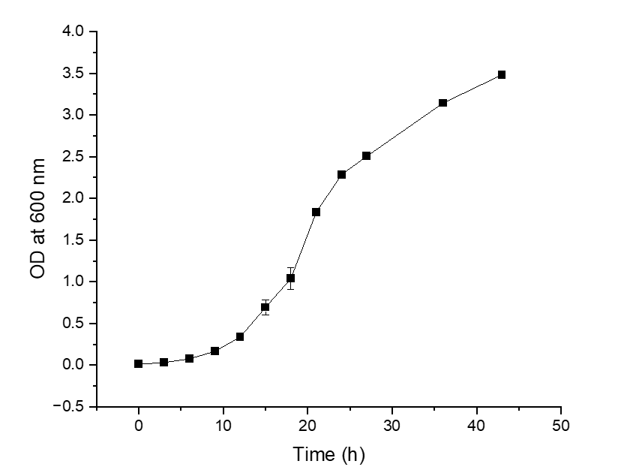
Results & Discussion
Microbial Kinetics study of L. mesenteroides
Growth Kinetics Analysis: OD (Optical Density) at 600 nm was used to correlate with cell density in MRS media.
Conclusion: OD of 0.9 ( ~ 10⁹ CFU/ml) during log phase was selected for further experimental studies.
Inoculation: MRS broth was inoculated with 1% secondary culture of L. Mesenteroides.
Observation: Log phase lies in between 12 h to 24 h.

Slide 11
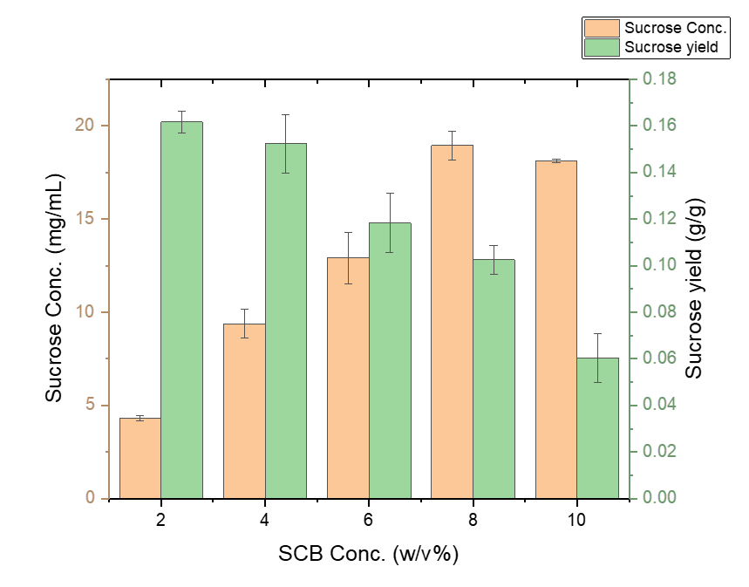
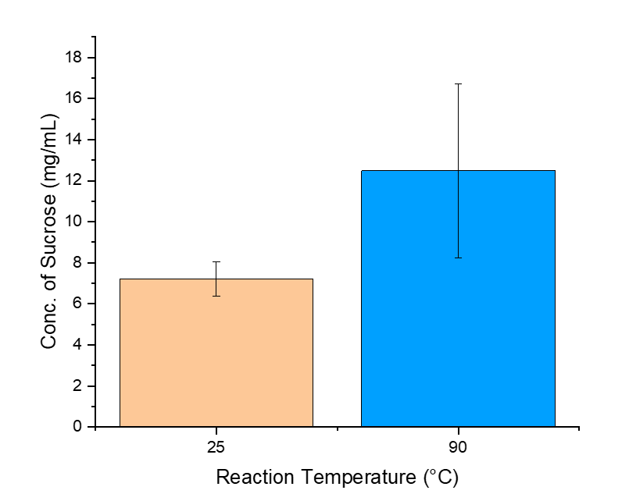
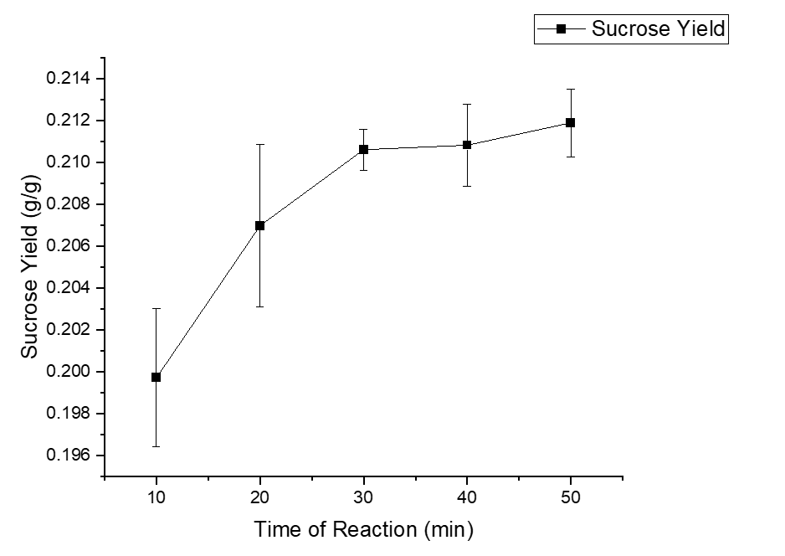
Extraction of Sucrose from Sugarcane Bagasse
Effect of SCB Concentration
Effect of Time
Hold value – Extraction at 90 ℃ SCB for 60 minutes
Hold value – Extraction at 90 ℃ SCB at 4% SCB conc for 30 minutes
Effect of Temperature
Hold value – Extraction at 5% SCB for 60 minutes
Observation: At higher temperature, higher amount of sucrose was extracted from SCB.
Reason: Due to increased solubility of sucrose, hydrolysis of structural components, and possible degradation of structural integrity of SCB.
Conclusion: For further studies aqueous extraction of sucrose was selected at 90 ℃.
Effect of SCB conc. varied from 2-10% of feedstock to evaluate the effect of sucrose conc.
Observation: Higher conc. of SCB resulted in Higher conc. of sucrose but sucrose yield gets saturated after 4% SCB conc.
Reason: due to the entrapment of sucrose in the interior of SCB, increase in viscosity of slurry and the unavailability of enough solvent to facilitate sucrose diffusion to the liquid phase.
Conclusion: 4% SCB conc. was selected for further studies.
The influence time on the extraction of sucrose was studied over a range of 10 – 50 mins.
Observation: After 30 mins of incubation sucrose concentration has saturated, indicating a maximum removal of sucrose from SCB
Conclusion: For further studies aqueous extraction of sucrose was selected at 90℃ and 4% SCB concentration for 30 mins.

Slide 12
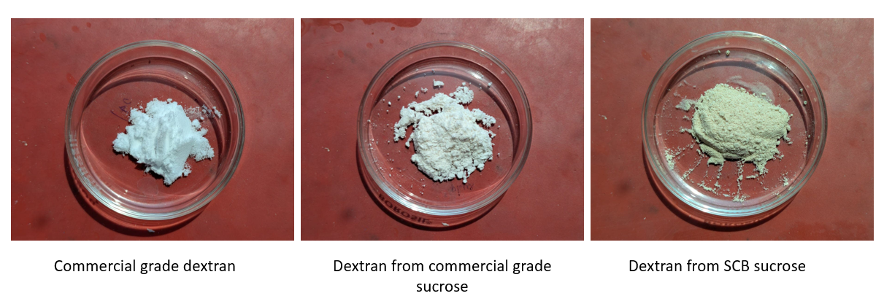
Synthesis, Recovery and Purification of Dextran
Dextran is produced using L.mesenteroides.
Here, the dextran from commercial grade sucrose is pure than the dextran from SCB sucrose, which suggests SCB dextran needs to be washed with ethanol further.

Slide 13
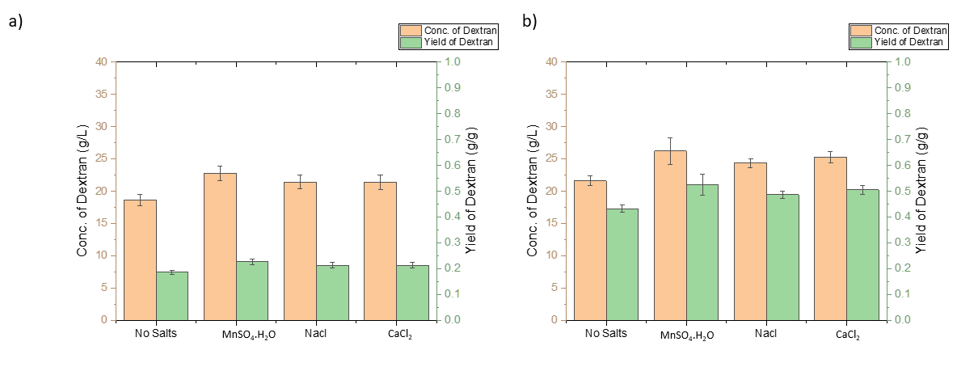
Effect of Individual Salts
Synthesis of Dextran from commercial grade sucrose
Synthesis of Dextran from SCB sucrose
MnSO4.H2O had the highest positive impact on dextran yield among all individual salts tested.

Slide 14
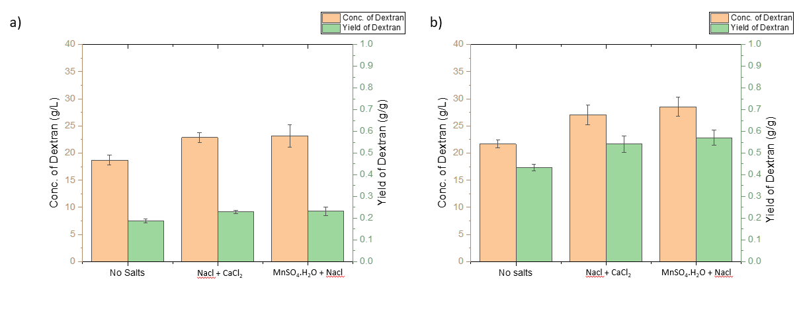
Effect of Two Salts
Synthesis of Dextran from commercial grade sucrose
Synthesis of Dextran from SCB sucrose
MnSO₄·H₂O + NaCl has the highest yield among double salts.
For MnSO₄·H₂O + CaCl₂ experiment not feasible due to precipitation.

Slide 15
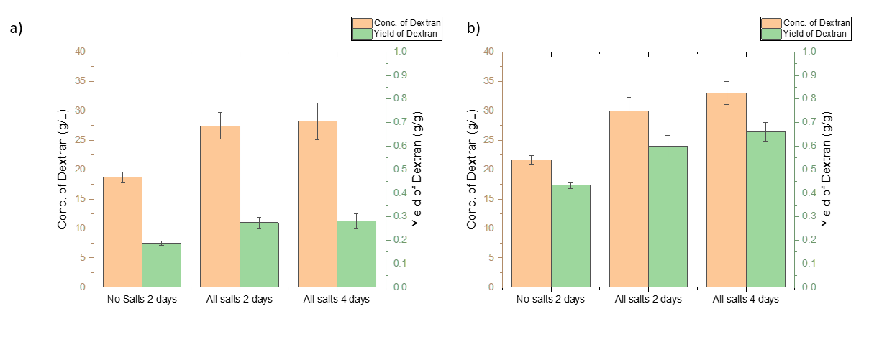
Effect of Fermentation Time
Synthesis of Dextran from commercial grade sucrose
Synthesis of Dextran from SCB sucrose
MnSO₄·H₂O + CaCl₂ + NaCl ~Resulted in the highest dextran yield, more than individual or dual combinations.
Here, the dextran yield was monitored over a range of fermentation durations and peak production observed at
Day 4 i.e. 0.2821 g/g using commercial sucrose and 0.661 g/g using SCB-derived sucrose.

Slide 16
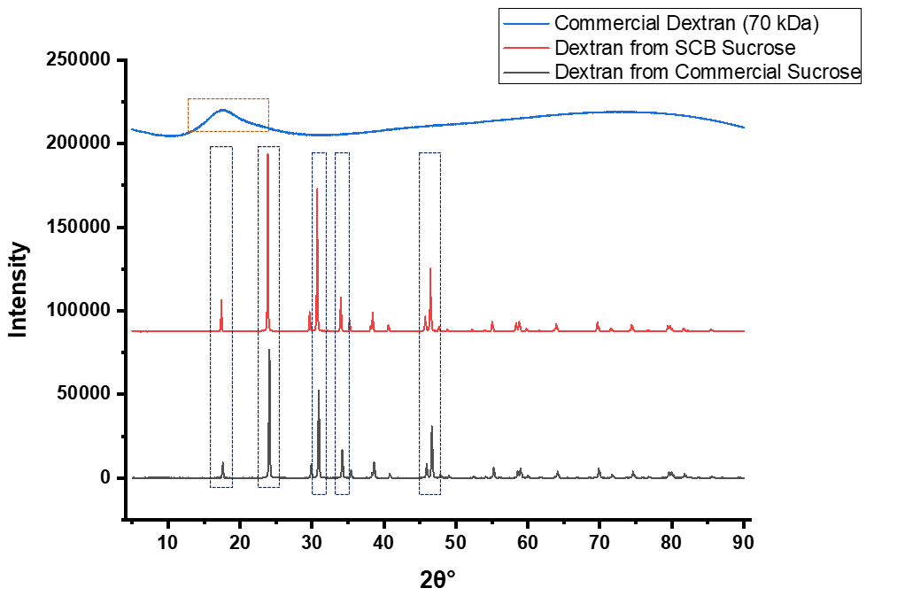
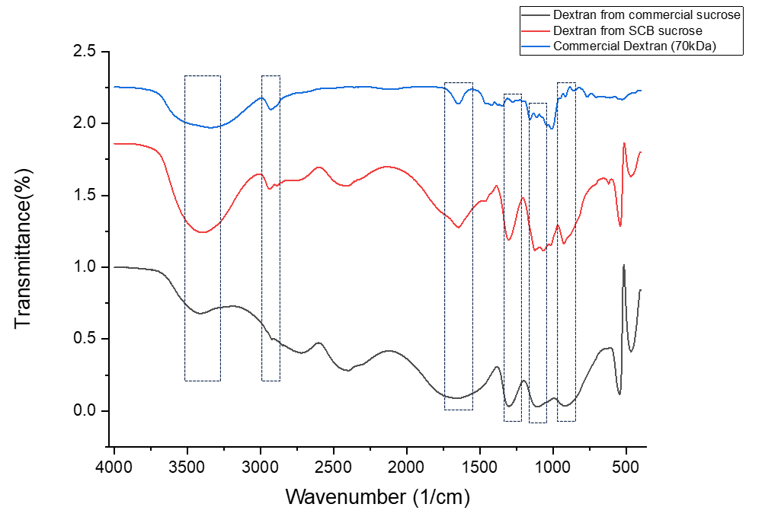
Characterization of dextran
FTIR Spectroscopy
XRD Analysis
O-H Stretching (3400–3500 cm⁻¹)
C-H Stretching (2925 cm⁻¹ and 1636 cm⁻¹)
C–O–C Vibration (1153 cm⁻¹)
α-(1→6) Glycosidic Bonds (1018 cm⁻¹)
α-(1 → 4) Glycosidic linkages (906 cm⁻¹)
Conclusion: Presence of Dextran
(Yilmaz et al ., 2022) reported that 5 peaks around 2θ ≈ 17°, 24°, 31°, 34°, and 47° indicates High crystalline structure and this can be due to the reduction of (1 → 4)-linked α-d-glucose units as branching points in the dextran from SCB sucrose and commercial sucrose.

Slide 17
Conclusion
Aqueous extract SCB was successfully utilized as an alternative sucrose source for dextran production.
L. mesenteroides was able to survive and efficiently produce dextran in SCB extract.
Dextran yield from SCB was comparable to commercial sucrose, although further purification is needed.
FT-IR confirmed the presence of dextran; XRD revealed its crystalline nature.
Future Perspectives
Optimization of Fermentation parameters to enhance dextran yield.
Better purification techniques to improve dextran quality and applicability.
Functional characterization of SCB-derived dextran for biomedical and pharmaceutical applications.
Notes:
(Talking about applications~ Flim making, rheology modifier, Sweetener etc.)
Sustainability – Process driven

Slide 18
References
Aman, A., Siddiqui, N.N. and Qader, S.A.U., 2012. Characterization and potential applications of high molecular weight dextran produced by Leuconostoc mesenteroides AA1. Carbohydrate Polymers, 87(1), pp.910-915.
Chae, E., Moon, J.S., Jung, J.Y., Kim, J.S., Eom, H.J., Kim, S.Y., Yoon, H.S. and Han, N.S., 2009. Buffering effects of calcium salts in kimchi: lowering acidity, elevating lactic acid bacterial population and dextransucrase activity.
Du, R., Pei, F., Kang, J., Zhang, W., Wang, S., Ping, W., Ling, H. and Ge, J., 2022. Analysis of the structure and properties of dextran produced by Weissella confusa. International Journal of Biological Macromolecules, 204, pp.677-684.
Finley, J.W. and Fellers, D.A., 1973. Sucrose determination by a modified anthrone method. Application with sweetened wheat-soy blend and corn-soy-milk.
Han, J., Hang, F., Guo, B., Liu, Z., You, C. and Wu, Z., 2014. Dextran synthesized by Leuconostoc mesenteroides BD1710 in tomato juice supplemented with sucrose. Carbohydrate polymers, 112, pp.556-562.
Huang, K.P. and Robinson, J.C., 1977. Effect of manganese (ous) and sulfate on activity of human placental glucose 6-phosphate-dependent form of glycogen synthase. Journal of Biological Chemistry, 252(10), pp.3240-3244.
Jiang, Z., Sun, K., Wu, H., Dong, W., Ma, J. and Jiang, M., 2023. Preparation and Characterization of a Novel Morphosis of Dextran and Its Derivatization with Polyethyleneimine. Molecules, 28(20), p.7210.
Kajala, I., Mäkelä, J., Coda, R., Shukla, S., Shi, Q., Maina, N.H., Juvonen, R., Ekholm, P., Goyal, A., Tenkanen, M. and Katina, K., 2016. Rye bran as fermentation matrix boosts in situ dextran production by Weissella confusa compared to wheat bran. Applied Microbiology and Biotechnology, 100, pp.3499-3510.
Kedaria, D. and Vasita, R., 2017. Bi-functional oxidized dextran–based hydrogel inducing microtumors: an in vitro three-dimensional lung tumor model for drug toxicity assays. Journal of Tissue Engineering, 8, p.2041731417718391.
Miljković, M.G., Davidović, S.Z., Carević, M.B., Veljović, Đ.N., Mladenović, D.D., Rajilić-Stojanović, M.D. and Dimitrijević-Branković, S.I., 2016. Sugar beet pulp as Leuconostoc mesenteroides T3 support for enhanced dextransucrase production on molasses. Applied biochemistry and biotechnology, 180, pp.1016-1027.
Moosavi-Nasab, M., Alahdad, Z. and Nazemi, S.H., 2010. Characterization of the dextran produced by Leuconostoc mesenteroides from date fruit extract. Iran Agricultural Research, 27(1.2), pp.79-88.
Onilude, A.A., Olaoye, O., Fadahunsi, I.F., Owoseni, A., Garuba, E.O. and Atoyebi, T., 2013. Effects of cultural conditions on dextran production by Leuconostoc spp. International Food Research Journal, 20(4), p.1645.
Paulo, E.M., Boffo, E.F., Branco, A., Valente, Â.M., Melo, I.S., Ferreira, A.G., Roque, M.R. and Assis, S.A.D., 2012. Production, extraction and characterization of exopolysaccharides produced by the native Leuconostoc pseudomesenteroides R2 strain. Anais da Academia Brasileira de Ciências, 84, pp.495-508.
Rahman, S.S.A., Venkatachalam, P. and Karuppiah, S., 2022. Cost-effective production of dextran using Saccharum officinarum juice (SOJ) as a potential feedstock: downstream processing and characterization. Biomass Conversion and Biorefinery, 12(11), pp.4863-4875.
Sarwat, F., Qader, S.A.U., Aman, A. and Ahmed, N., 2008. Production & characterization of a unique dextran from an indigenous Leuconostoc mesenteroides CMG713. International journal of biological sciences, 4(6), p.379.
Shibayama, J., Kuda, T., Shikano, A., Fukunaga, M., Takahashi, H., Kimura, B. and Ishizaki, S., 2018. Effects of rice bran and fermented rice bran suspensions on caecal microbiota in dextran sodium sulphate-induced inflammatory bowel disease model mice. Food Bioscience, 25, pp.8-14.
Tripathy, A., Patel, M.K. and Chakraborty, S., 2024. Microbial production of dextran using pineapple waste extract: a two-step statistical optimization of submerged fermentation conditions and structural characterization. Biotechnology and Bioprocess Engineering, 29(2), pp.387-403.
Wang, B., Wu, Y., Li, Q., Wu, X., Kang, X., Zhang, L., Lyu, M. and Wang, S., 2024. The Screening and Identification of a Dextranase-Secreting Marine Actinmycete Saccharomonospora sp. K1 and Study of Its Enzymatic Characteristics. Marine Drugs, 22(2), p.69.
Wang, D., Tian, J., Guan, J., Ding, Y., Wang, M.L., Tonnis, B., Liu, J. and Huang, Q., 2022. Valorization of sugarcane bagasse for sugar extraction and residue as an adsorbent for pollutant removal. Frontiers in Bioengineering and Biotechnology, 10, p.893941.
Yilmaz, M.T., İspirli, H., Taylan, O., Bilgrami, A.L. and Dertli, E., 2022. Structural and bioactive characteristics of a dextran produced by Lactobacillus kunkeei AK1. International Journal of Biological Macromolecules, 200, pp.293-302.
Zhang, Y., Han, Y. and Zhou, Z., 2024. A novel multifunctional composite film of oxidized dextran crosslinked chitosan and ε-polylysine incorporating protocatechuic acid and its application in meat packaging. Food Hydrocolloids, 146, p.109186.

Slide 19
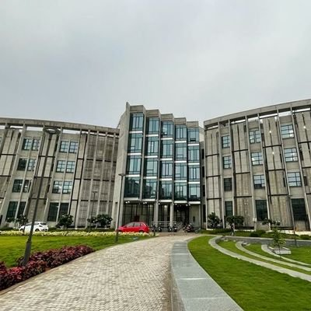
Acknowledgements
Supervisor:
Dr. Althuri Avanthi
Assistant Professor, Department of Biotechnology
Research Lab mates:
Bhavya Surendran V S
Mohit Kumar Mehra
Sumona Garg
Sruthi B
Vinith Kumar
Kuldeep Singh
Ayan Banerjee
Gouri R Nair

Slide 20
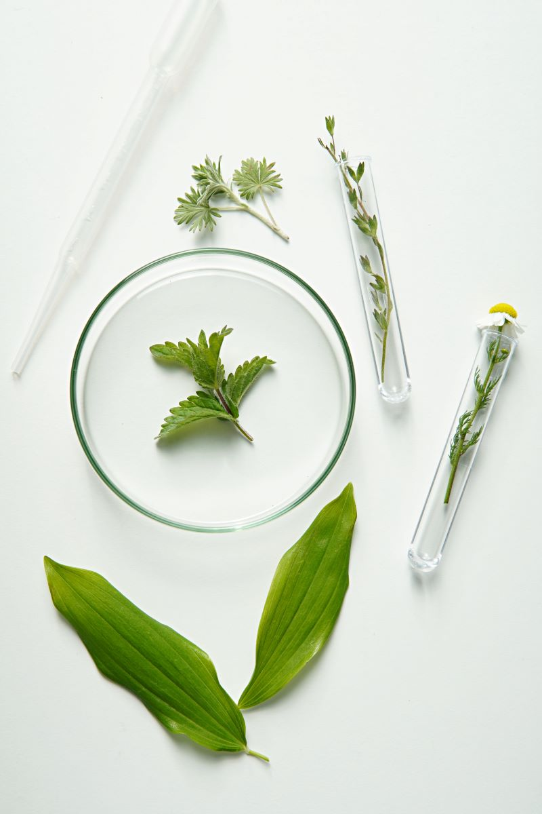
Thank You

